Slide 1
Finding Inexact Quotations Within a Tibetan Buddhist Corpus
Benjamin Eliot Klein, Nachum Dershowitz, Lior Wolf,
Orna Almogi, and Dorji Wangchuk

Slide 2
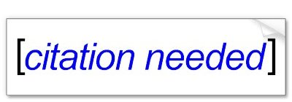
Introduction
literary scholars look for textual citations
In historical works, even quotations are frequently quite inexact
no indication that a passage is being quoted or work is being cited.
Our Goal: identify pairs of nearly identical strings

Slide 3
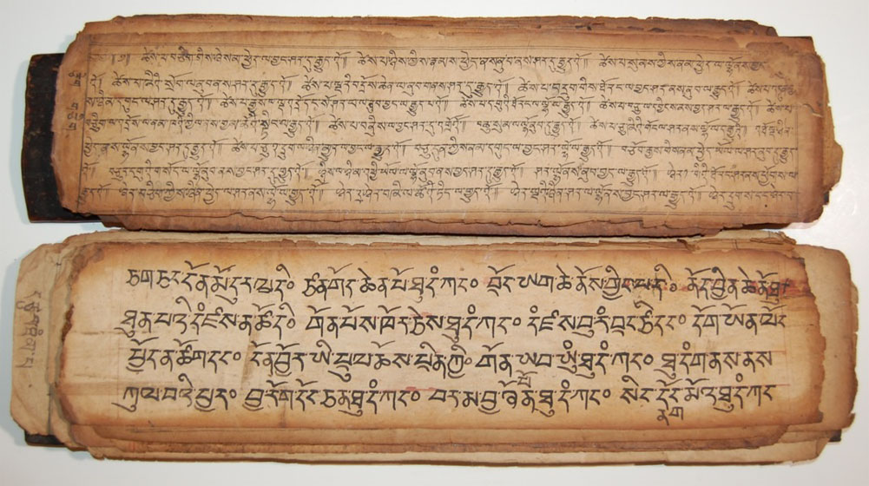
Tibetan Buddhist canon
currently being digitized
300 volumes
800 pages per volume
200 words in a page
Words in Tibetan are predominantly monosyllabic

Slide 4
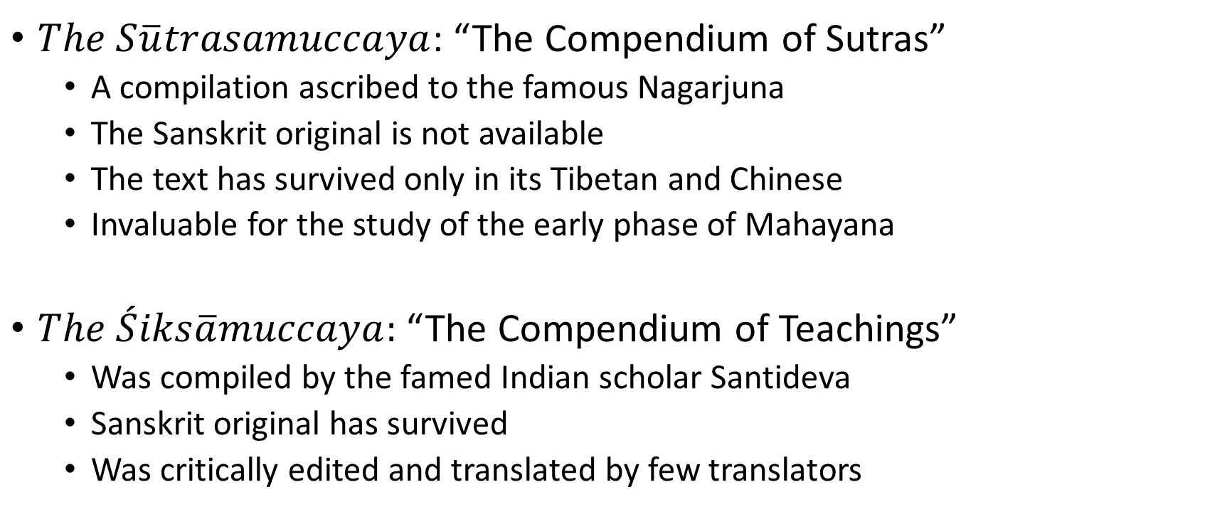
The Corpus
$The$ $S\overline{u}trasamuccaya$: “The Compendium of Sutras”
A compilation ascribed to the famous Nagarjuna
The Sanskrit original is not available
The text has survived only in its Tibetan and Chinese
Invaluable for the study of the early phase of Mahayana
$The \acute{S}iks\overline{a}muccaya:$ “The Compendium of Teachings”
Was compiled by the famed Indian scholar Santideva
Sanskrit original has survived
Was critically edited and translated by few translators

Slide 5
Method
We worked with transliterations of the Tibetan texts
Used a parallelized version of a “threshold all against-all substring matching” algorithm
Union near and overlapping matches
Built an interface for investigating the matches

Slide 6
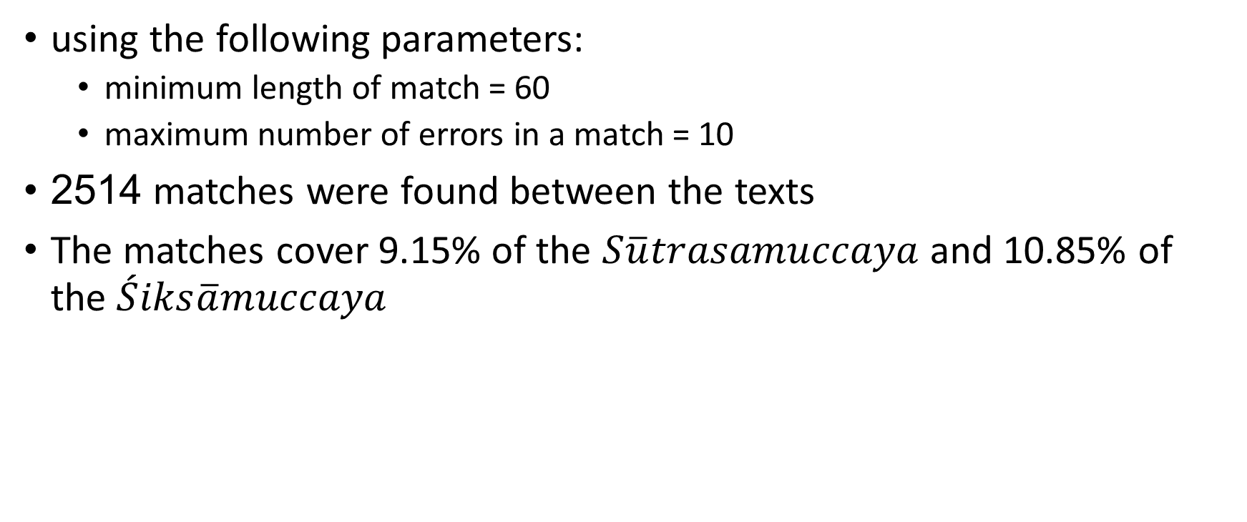
Results
using the following parameters:
minimum length of match = 60
maximum number of errors in a match = 10
2514 matches were found between the texts
The matches cover 9.15% of the $S\overline{u}trasamuccaya$ and 10.85% of the $\acute{S}iks\overline{a}muccaya$

Slide 7
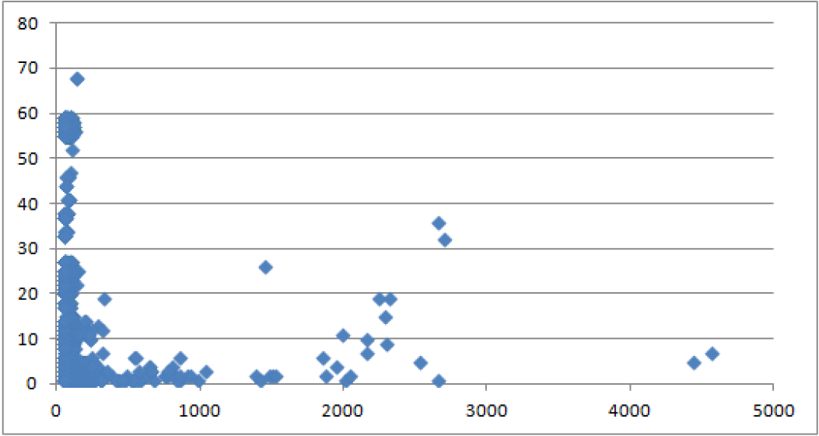
Match Length Histogram
Notes:
Fig. 1. Histogram depicting the count (y-axis) of matching texts of a certain length
(x-axis) [the length in Sutrasamuccaya]. As can be seen, while most of the matches
are for texts of up to 200 characters (median=61), there are also matches for texts of
a few thousand characters. Note that some texts (including long ones) have multiple
matches.

Slide 8
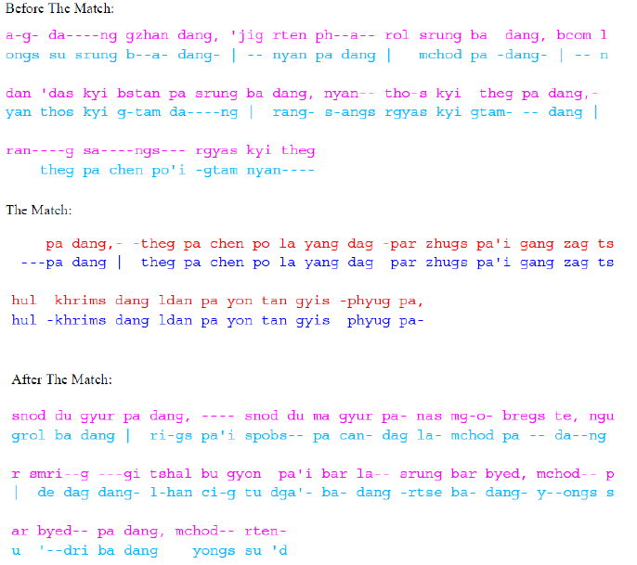
Examples of quotations found
Notes:
Fig. 2. Examples of quotations found. (a) The quotations with the 90th highest score,
including its context, before and after. Line breaks have no signicance. (Vertical bars
serve as commas.) Two hues depict the two texts, red/pink for the Sutrasamuccaya and
blue/magenta for the Siks.amuccaya.

Slide 9
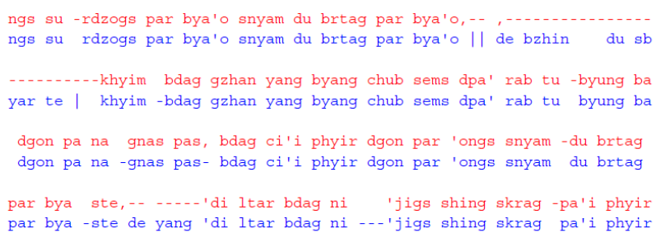
Another example
Notes:
Part of the quotation with the fourth highest
score, which is relatively clean except for some omissions.

Slide 10
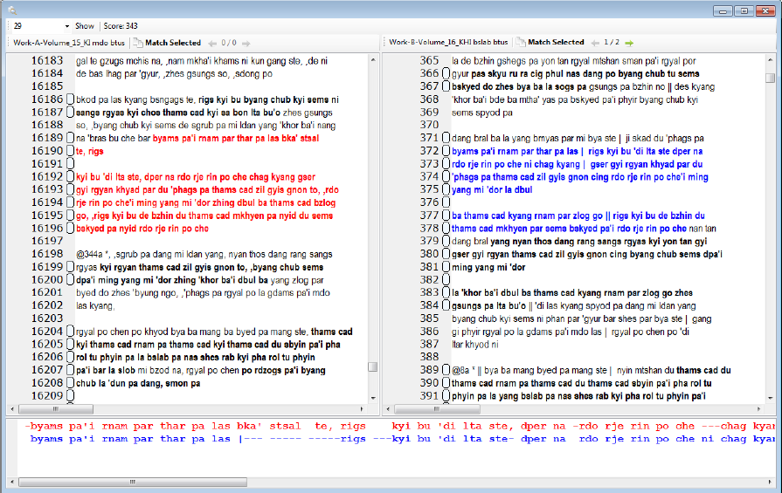
A screenshot of the user interface
Notes:
Fig. 3. A screenshot of the user interface, with the two matching texts are displayed side by side. The text regions for which matching
texts exist are emboldened. The rst out of two texts that match the blue text are shown in red. This match has a score of 343 and is
ranked 19th out of all matches. The panel at the bottom of the screen displays the two texts aligned character by character.

Slide 11
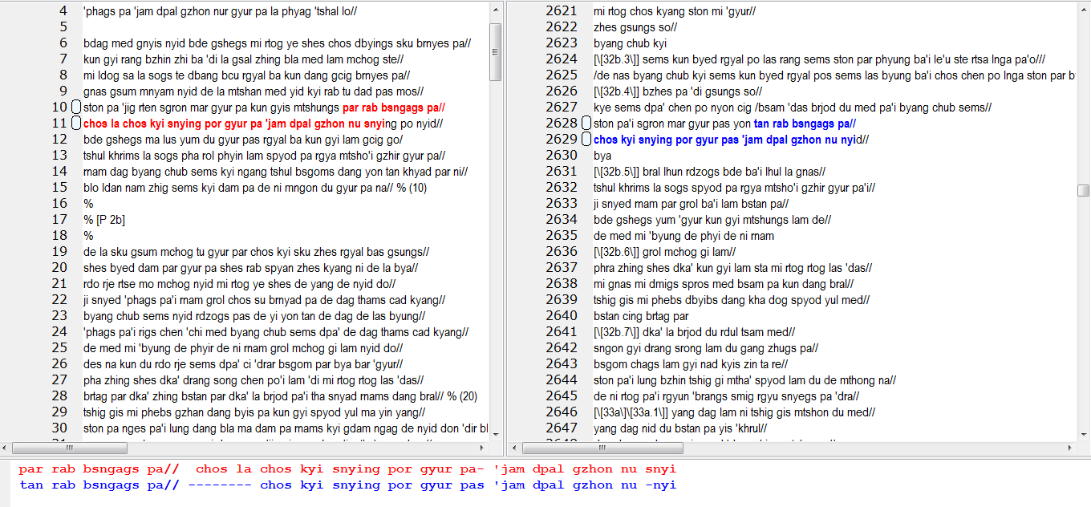
Another screenshot
Notes:
The match from the example you sent me…

Slide 12
What’s Next?
Allow more errors as the match grows
Adding some nlp tools like stemming (soundex,etc.)
Adding semantics

